Slide 1
C++ Programming Design
Session #4

Slide 2
#4
4.1 Compound Types
4.2 Loops and Relational Expressions
Branching Statements and Logical Operators

Slide 3
#4.1 Compound Types
Reviewing arrays and C-style strings
The vector and array classes
Creating and using string-class strings, getline() and get()
Mixing string and numeric input
Reviewing structures, unions, enumerations
Reviewing pointers
Managing dynamic memory with new and delete
Automatic, static, and dynamic storage

Slide 4
Arrays
An array declaration should indicate three things:
(1)The type of value to be stored in each element
(2)The name of the array
(3)The number of elements in the array
Example:
short months[12];

Slide 5
Arrays: Initialization
int cards[4] = {3, 6, 8, 10}; // okay
int hand[4]; // okay
hand[4] = {5, 6, 7, 9}; // not allowed
hand = cards; // not allowed
float hotelTips[5] = {5.0, 2.5}; // okay
long totals[500] = {0}; // okay
short things[] = {1, 5, 3, 8}; // okay

Slide 6
Arrays: Initialization in C++11
(1)double earnings[4] {1.2e4, 1.6e4, 1.1e4, 1.7e4};
// okay with C++11
(2) unsigned int counts[10] = {}; // all elements set to 0
float balances[100] {}; // all elements set to 0
(3) long plifs[] = {25, 92, 3.0}; // not allowed
char slifs[4] {'h', 'i', 1122011, '\0'}; // not allowed
char tlifs[4] {'h', 'i', 112, '\0'}; // allowed

Slide 7
Arrays: vector Template Class in C98
(1) #include <vector>
(2) General declaration:
vector<typeName> vt(n_elem);
where n_elem is const or variable.
(3) Examples:
vector<int> vi; // create a zero-size array of int
int n;
cin >> n;
vector<double> vd(n); // create an array of n doubles

Slide 8
Arrays: vector Template Class in C98
(4) Cannot be simply initialized.
vector<double> a2(4); // create vector with 4 elements
a2[0] = 1.0/3.0;
a2[1] = 1.0/5.0;
a2[2] = 1.0/7.0;
a2[3] = 1.0/9.0;

Slide 9
Arrays: array Template Class in C++11
(1) #include <array>
(2) General declaration:
array<typeName, n_elem> arr;
where n_elem is const.
(3) Examples:
array<int, 5> ai; // create array object of 5 ints
array<double, 4> ad = {1.2, 2.1, 3.43. 4.3};
Why vector and array are both introduced?

Slide 10
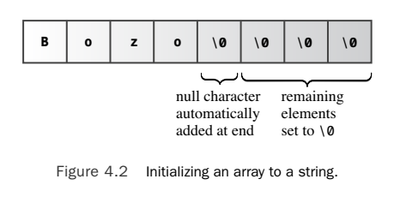
Strings: C-style
char boss[8] = "Bozo";

Slide 11
Strings: Concatenating String Literals
C++ enables to concatenate string literals
Example:
(1)cout << “AAA" " BBB.\n";
(2)cout << " AAABBB.\n";
(3)cout << “AAA"
“BBB";

Slide 12
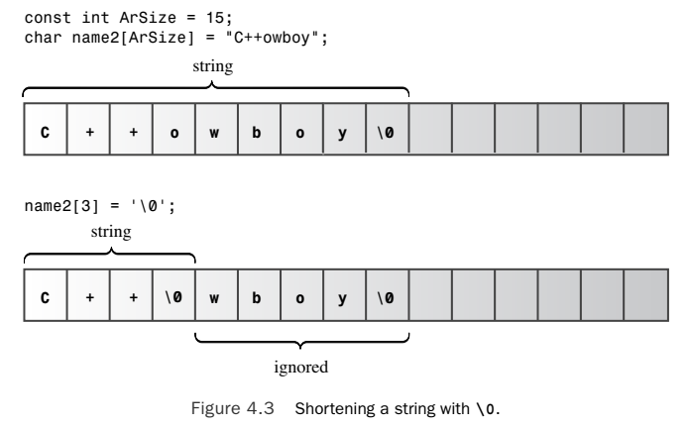
Strings: Note

Slide 13
Strings: cin
(1)cin>> can be used for string input.
(2)cin is to use whitespace—spaces, tabs, and newlines—to delineate a string

Slide 14
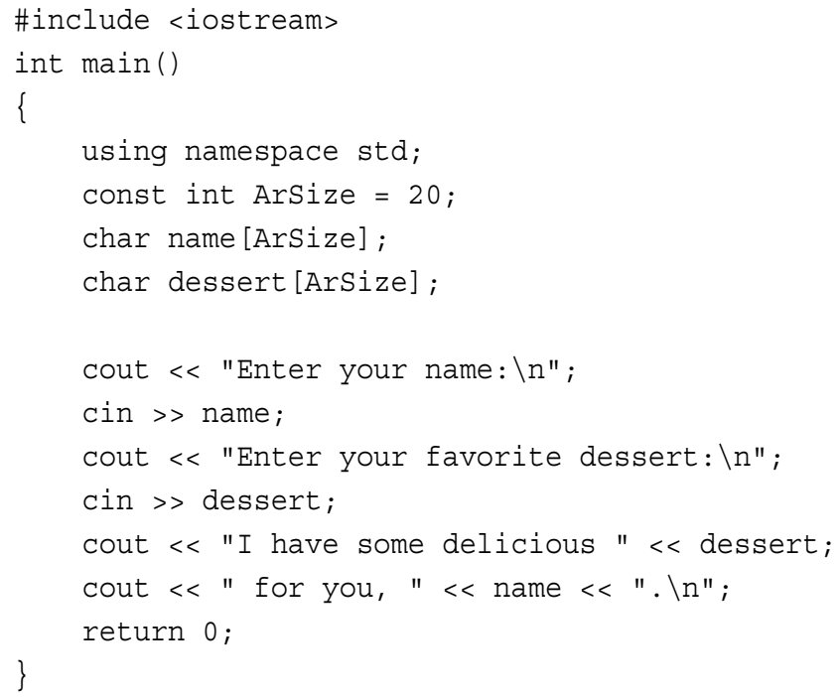
Strings:
OUTPUT:
Enter your name:
Alistair Dreeb
Enter your favorite dessert:
I have some delicious Dreeb for you, Alistair.

Slide 15
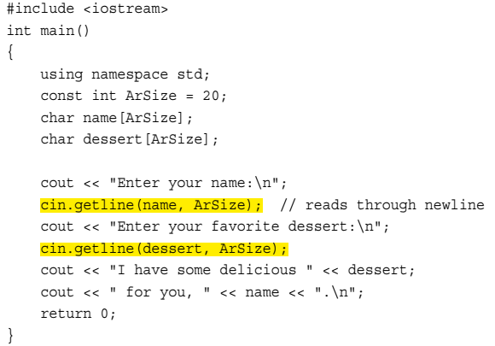
Strings: cin.getline(), get()
OUTPUT:
Enter your name:
Dirk Hammernose
Enter your favorite dessert:
Radish Torte
I have some delicious Radish Torte for you, Dirk Hammernose.

Slide 16
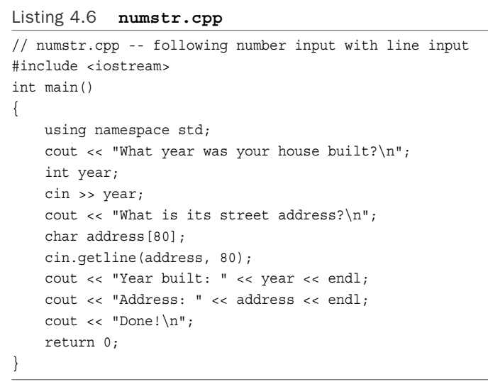
Strings: Mixing String and Numeric Input

Slide 17
Strings: Mixing String and Numeric Input
OUTPUT:
What year was your house built?
1966
What is its street address? Year built: 1966 Address:
Done!

Slide 18
Strings: Mixing String and Numeric Input
Reason: a newline in the queue
Fix: cin >> year; cin.get();
or (cin >> year).get();

Slide 19
Strings: string class in C++
(1)#include <string>
(2)string in namespace std;
(3)Definition and using:
string str2 = "panther";
cin>>str2;
cout<<str2;
(4)Assignment, Concatenation, and Appending:
string str1, str2, str3;
str3 = str1 + str2; // assign str3 the joined strings
str1 += str2; // add str2 to the end of str1

Slide 20
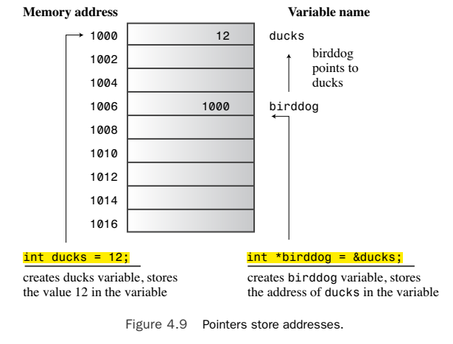
Pointers

Slide 21
Pointers: const
int x=5;
int * p0=&x;
const int * p1=&x; //pointer pointing to const
int const * p2=&x; //pointer pointing to const
int * const p3=&x; //const pointer

Slide 22
Pointers: new and delete
(1)Dynamical memory allocation
(2)C: malloc() and free()
(3)C++: new and delete //must be paired
typeName * pointer_name = new typeName;
delete pointer_name;
typeName * pointer_name = new typeName[n];
delete [] pointer_name;
Variables
Arrays

Slide 23
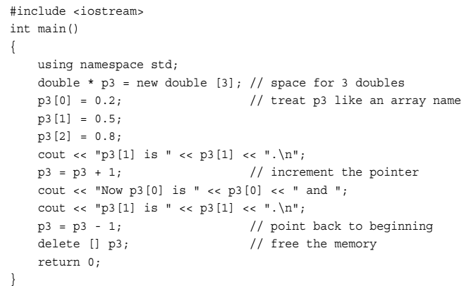
Pointers: Example 1 on new and delete

Slide 24
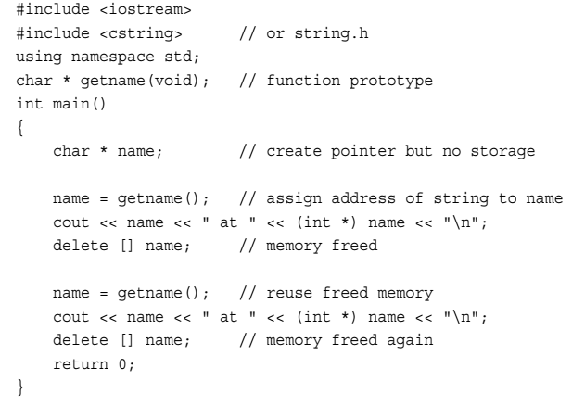
Pointers: Example 2 on new and delete

Slide 25
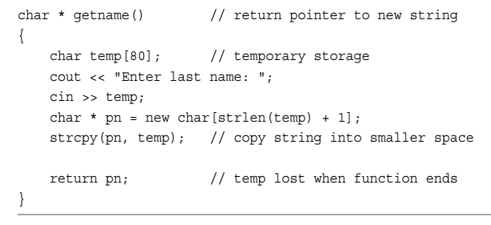
Pointers: Example 2 on new and delete

Slide 26
Pointers: NOTE
short tell[10]; // tell an array of 20 bytes
cout<< tell << endl; // displays &tell[0]
cout<< &tell << endl; // displays address of whole array
tell, is the address of a 2-byte block of memory
and its type is short *.
&tell is the address of a 20-byte block of memory.
and its type is short (*)[20].
tell+1
&tell+1

Slide 27
Pointers: C++11 Null Pointer
In C++98, the literal 0 has two meanings—it can be the numeric value 0, and it can be the null pointer—thus making it difficult for the reader and compiler to distinguish between the two.
Sometimes programmers use (void *) 0 to identify the pointer version. (The null pointer itself may have a nonzero internal representation.)
Other programmers use NULL, a C macro defined to represent the null pointer. However, this proved to be an incomplete solution.

Slide 28
Pointers: C++11 Null Pointer
C++11 provides a better solution by introducing a new keyword, nullptr, to denote the null pointer.
You still can use 0 as before—otherwise an enormous amount of existing code would be invalidated—but henceforth the recommendation is to use nullptr instead:
str = nullptr; // C++11 null pointer notation

Slide 29
Scope and lifetime
(1)Automatic Storage
(2)Static Storage
(3)Dynamic Storage

Slide 30
Programming Exercises
4.1 Write a C++ program that requests and displays information as shown in the following example of output:
What is your first name? Betty Sue
What is your last name? Yewe
What letter grade do you deserve? B
What is your age? 22
Name: Yewe, Betty Sue
Grade: C
Age: 22

Slide 31
Programming Exercises
4.1 Continued: Note that the program should be able to accept first names that comprise more than one word. Also note that the program adjusts the grade downward—that is, up one letter.

Slide 32
Programming Exercises
4.2 William Wingate runs a pizza-analysis service. For each pizza, he needs to record the following information:
(1)The name of the pizza company, which can consist of more than one word
(2)The diameter of the pizza
(3)The weight of the pizza
Use new to allocate a structure. Also have the program request the pizza diameter before it requests the pizza company name.

Slide 33
Programming Exercises
4.3 Write a program that requests the user to enter three times for the 40-yd dash (or 40-meter, if you prefer) and then displays the times and the average. Use an array or vector object to hold the data.

Slide 34
On Control Structures and Functions
#4.2 Loops and Relational Expressions
Branching Statements and Logical Operators

Slide 35
Programming Exercises
4.4 Design a structure called car that holds the following information about an automobile: its make, as a string in a character array or in a string object, and the year it was built, as an integer. Write a program that asks the user how many cars to catalog. The program should then use new to create a dynamic array of that many car structures. Next, it should prompt the user to input the make (which might consist of more than one word) and year information for each structure.

Slide 36
Programming Exercises
4.4 Continued: Finally, it should display the contents of each structure. A sample run should look something like the following:
How many cars do you wish to catalog? 2
Car #1:
Please enter the make: Hudson Hornet
Please enter the year made: 1952
Car #2:
Please enter the make: Kaiser
Please enter the year made: 1951
Here is your collection:
1952 Hudson Hornet
1951 Kaiser

Slide 37
Programming Exercises
4.5 The Kingdom of Neutronia, where the unit of currency is the tvarp, has the following income tax code:
First 5,000 tvarps: 0% tax
Next 10,000 tvarps: 10% tax
Next 20,000 tvarps: 15% tax
Tvarps after 35,000: 20% tax
For example, someone earning 38,000 tvarps would owe 5,000 × 0.00 + 10,000 ×0.10 + 20,000 × 0.15 + 3,000 × 0.20, or 4,600 tvarps. Write a program that uses a
loop to solicit incomes and to report tax owed. The loop should terminate when the user enters a negative number or non-numeric input.

